Slide 1

Integers–
Metal mercury at room temperature is a liquid. Its melting point is ⁻39°C. The freezing point of alcohol is ⁻14°C. How much warmer is the freezing point of alcohol than the melting point of mercury?
Dailies Set #1

Slide 2

Rectangle –
A farmer has 200 feet of fencing. What is the largest area of land that can be enclosed if the farmer plans to use a rectangular design?

Slide 3

Scientific Notation –
Astronomers measure distance between the sun and the planets using Astronomical Units (AU). 1 AU is the distance from Earth to the Sun. Pluto orbits the sun on a highly elliptical path. If at its closest point, Pluto is 29 astronomical units from the sun (2.75 x 10⁹ miles), how far is the distance from Earth to the Sun.

Slide 4
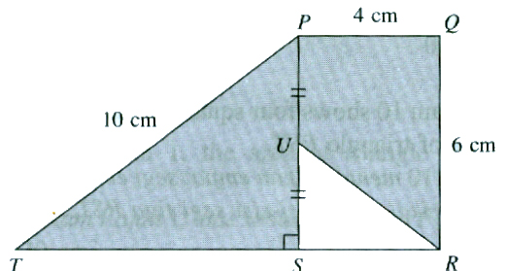
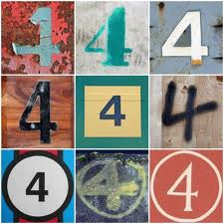
Area –
A company’s logo takes on the general shape below. The logo is to be embroidered on t-shirts for the company’s employees. How many square centimeters of space will the blue part of the logo take up? How many square centimeters of space will the white part of the logo take up?
blue
blue
white
8 cm

Slide 5

Sequence –
Calculate the 30th term of the sequence shown below.
-4, -2.6, -1.2, 0.2, …

Slide 6



Sales Tax –
You buy the new FIFA14 soccer game at Gamestop for $59.99. Will you actually pay $59.99 for the game? Why or why not? If not, how much will you actually pay for the game?
Dailies Set #2

Slide 7

Odd Number –
A farmer says that he has an odd number of pigs in each of his pig pens.
Does the farmer have: a. 21 pigs and 4 pig pens b. 23 pigs and 5 pig pens c. 25 pigs and 6 pig pens
Use math to support your answer.

Slide 8

Complementary Angles –
A carpenter is building a frame around a door. He says to his client, “The upper corners of the frame will have equivalent, complementary angles.”
Draw an accurate picture of the carpenter’s door frame.

Slide 9

Supplementary Angles –
An amateur carpenter was told to cut two angles, one at 145⁰ and one at 35⁰, so that it formed supplementary angles. The carpenter accidently cut the first piece to be 131⁰. How many degrees should the carpenter cut the second piece so that if still forms supplementary angles?

Slide 10

Absolute Value –
On first down, the Steelers gained 7 yards. On second down, the quarterback was sacked in the backfield for a loss of 12 yards. On third down, a completion allowed them to gain 2 yards. Overall, how far away from the team’s starting point is the ball? How may yards does the team need to earn a first down (10 yards past their starting point)?

Slide 11

Arc –
A section of a street league skateboarding park is made using an arc from a complete circle. The arc is 64 feet. The complete circle is 160 feet. What fraction of the circle is the arc?
Dailies Set #3

Slide 12

Rate –
You are offered four different job offers. Which offer has the best rate? a. $14.50 for every 2 hours of work b. $32.10 for every 5 hours of work c. $57.92 for every 8 hours of work d. $72.00 for every 10 hours of work
Use math to support your answer.

Slide 13
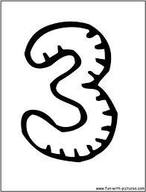
Commutative Property (include addition and multiplication) –
Describe how the commutative property could be used to quickly multiply the statement below using mental math.
Aaron received ½ of 7, 18 times in a row.

Slide 14

Circumference –
You work as a pool installation expert. You are asked to install a 16 foot diameter pool. How many feet of support panels will you need to encircle the pool (to construct the outside walls of the pool)?

Slide 15

Proportion –
You work as a product safety and reliability engineer. In a shipment of 400 parts, 14 were found to be defective. If a shipment of 1000 parts was shipped on the same day, how may parts can you predict are defective?

Slide 16

Zero Pairs (Integer Opposites) –
Sam is solving an integer addition math problem. The problem is -10 + 8. Sam says the answer is -2 because -10 is the same as -8 and -2. How did Sam use this fact to know the answer to his problem?
Dailies Set #4

Slide 17

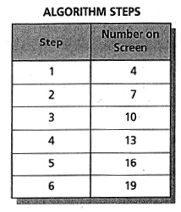
Algorithm –
Jill programmed her computer to perform an algorithm. At each step, her computer displays a number on the screen. The table shows the numbers the computer displays for the first six steps. If the pattern continues, what number will the computer display at step 50?

Slide 18

Greatest Common Factor –
Ella is making centerpieces for her wedding. She wants each centerpiece to be perfectly identical and she wants to use all the materials she has already purchased. So far, Ella has purchased 42 small candles, 91 flowers, and 28 mirrors.
How many centerpieces will Ella be able to make and how many of each item will be at each centerpiece?

Slide 19

Substitute –
You take a job as a truck driver. You are paid using a function of the number of miles you drive. Your total pay (t) is earned by $0.18 per mile (m) plus an additional $45 per day (d). Therefore, t=0.18m+45d. If you worked 5 days and drove 400 miles each day last week, how much money did you earn?

Slide 20

Conversion Factor –
Matt feeds his dog twice each day. Every time he feeds the dog, he gives him 4 ounces of food. How many pounds of food will the dog eat in a whole year?

Slide 21

Least Common Multiple –
Mrs. Daniel and her mom go running on Mount Union High School’s track. Mrs. Daniel can run 1 lap in 3 minutes. Her mom can run one lap in 2 ½ minutes. How many minutes will they need to run at their given paces to meet back up at their starting point? How many laps will this be for each person?
Dailies Set #5

Slide 22

Underestimate –
Kara’s mom is taking her school shopping at Kohl’s. A dress that originally costs $49.99 is on sale for 15% off. Kara’s mom can save an additional 20% by using her Kohl’s card. How much will Kara’s mom pay for the dress?

Slide 23

Unit Price –
At a surplus store, the manager buys cases of green beans for $4.50 each. To make a profit, the manager increases the price by $1.95 per case. If the case has 15 cans of green beans in it, what is the unit price that the customers will pay?

Slide 24

Even Number –
Lana and Wade are playing a number game. In order to win, you must solve a number puzzle within one minute. Wade asks Lana the following number puzzle. What numbers must Lana say in order to be correct?
What three consecutive even numbers have a sum of 318?

Slide 25

Prime Factors –
Manuel, Kayla, Michael, and Yvette are trying to find the prime factorization of 120.
Manuel says, “The prime factorization for 120 is 23x3x5”
Kayla said, “Actually, it’s 2x2x3x10”
Michael said, “I got 2x5x2x2x3”
Yvyette said, “Well it could be 2x2x2x3x5x1.”
Who is right? Explain your reasoning.

Slide 26

Whole Number –
Dan can mow this yard in one hour. How many square feet can he mow per minute? How long would it take him to mow a lawn that is 4,800 square feet?
Dailies Set #6

Slide 27

Supplementary Angles –
You are hired as a contractor. You need to tell your employees how to join two pieces of wood to form a straight (180 degree) angle. Using only whole numbers, how many different possibilities exist for how to create the joint?

Slide 28

Secant –
Only one of the given pictures below is a secant. Which one is a secant and why? What are the names of the other pictures?
A
E
D
B
C

Slide 29

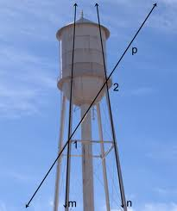
Transversal –
A water tower is to be built to look like the picture to the left. Line m and line n represent poles to hold the tower up and line p is a support pole. Since line m and line n are parallel to each other, what is the relationship between angle 1 and angle 2? Explain why using a vocabulary term.

Slide 30

Combination –
An ice cream stand serves five different flavors of ice cream. You order a large ice cream, which is 3 scoops. If each scoop can be the same or a different flavor, how many different large ice creams are you choosing from?

Slide 31

Experimental Probability –
You are playing the card game War with a friend. You tell your friend that with each round you have a 50/50 chance of winning. However, when you play the game, your friend wins 70 rounds and you win 30 rounds. What is the experimental probability of you winning?
Dailies Set #7

Slide 32
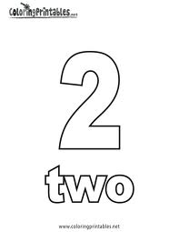
Transformation –
Find all the pairs of congruent pieces and describe the transformation that has occurred, using vocabulary such as translation, rotation, and reflection.

Slide 33

Inequality –
At Kohl’s Sara’s mom says, “You can spend NO MORE than $35.00.” Which inequality describes the amount of money (m) that Sara can spend? Why? m>35 m<35 m≥35 m≤35

Slide 34

Fundamental Counting Principle –
In Pennsylvania, a driver’s license number is made of 8 numbers. How many different driver’s licenses can be made using this format?

Slide 35

Equivalent Ratios –
Three separate buses are taken on a middle school field trip. The 6th grade bus contains 24 students and 6 chaperones. The 7th grade bus contains 36 students and 9 chaperones. The 8th grade bus contains 42 students and 14 chaperones. Which of the buses contain equivalent ratios of students to chaperones? How do you know?

Slide 36

Down Payment –
Kara is buying her first home for $125,000. Her bank requires a down payment of 15%. How much money will Kara need to have before purchasing her home?
Dailies Set #8

Slide 37
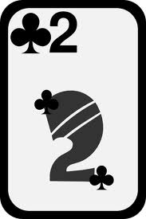
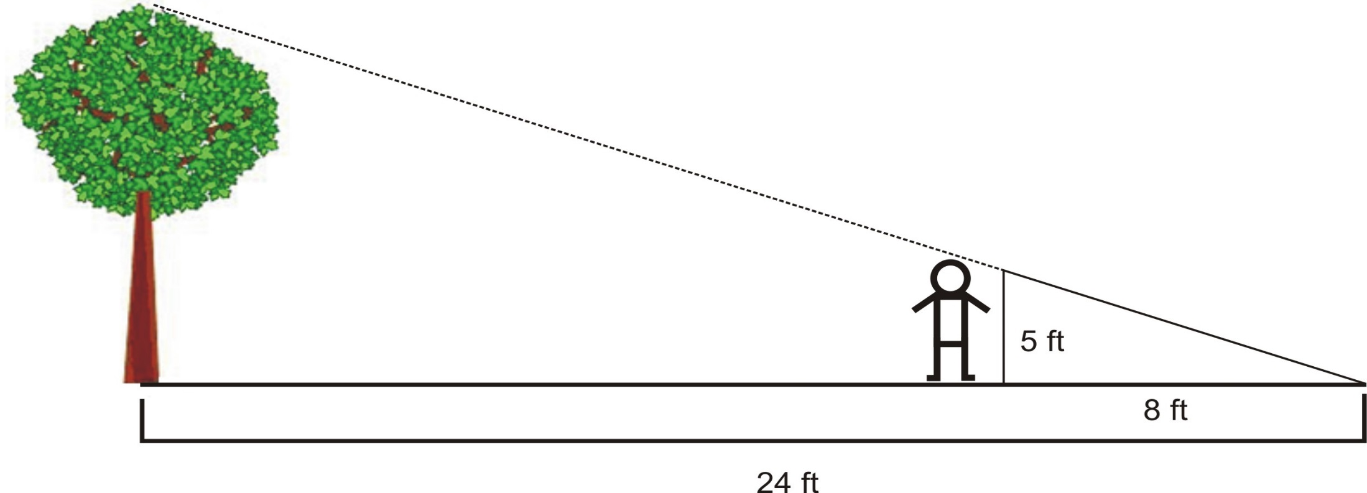
Similar Polygons –
If a 5 foot tall man casts a 8 foot shadow, how tall is a tree that casts a 24 foot shadow?

Slide 38

Mass –
The ratios of the gravitational force on the Moon to the gravitational force on Earth is 1:6. James has a mass of 84 kg on Earth. What is his mass on the moon?

Slide 39
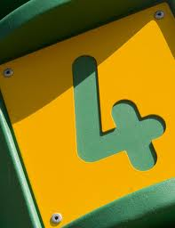
Difference –
At the end of the annual book fair, the students at Water Middle School found that they had $1,421.13 in the cash register. Their teacher had given them a loan of $97.89 to buy supplies for the fair. How much money will they have after they repay their teacher?

Slide 40
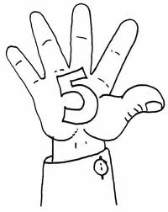
Principal –
Anna borrowed $150 from her mother and father to go on vacation with a friend. Anna said she will repay her parents an extra 10% of what she borrowed. How much money will she repay her parents in all? If she wants to repay them within 5 months, how much should she give them each month?

Slide 41
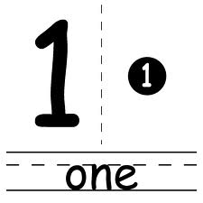
Unit Rate –
Cases of soda are sold as 24 packs.
Aaron buys two cases for $12.48.
Ben buys one case for $5.52.
Caleb buys three cases for $19.44.
Who received the best unit rate per can?
Dailies Set #9

Slide 42

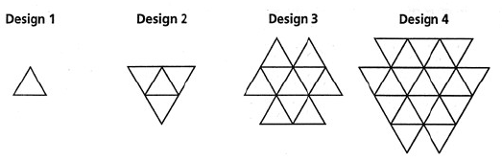
Equilateral Triangle –
Alicia is making a pattern with equilateral triangles. She started with one equilateral triangle and is adding equilateral triangles to the perimeter of each design. The first four designs are shown below. If Alicia continues the pattern, how many equilateral triangles will she add to Design 5 to get design 6?
Show your work in an organized way or explain your steps/thinking.

Slide 43

Equation –
Paul works during the summer painting houses. The total amount of money (t) he earns depends on the number of hours and days he works. He charges $7 per hour (h) plus an additional $15 per day (d) for gas. Write an equation that relates t, h, and d.

Slide 44

Percent –
Sara and Ben are offered two amounts of money from their parents.
Offer #1: 55% of $250
Offer #2: 20% of $600
Which offer would give Sara and Ben the most money to share?

Slide 45

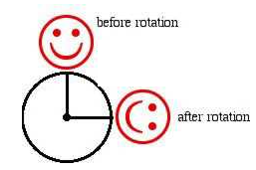
Clockwise –
Becky and Ally are given the picture below and asked to describe the transformation. Becky says that it has been rotated clockwise. Ally says that it has been rotated counterclockwise. Who is correct and why?

Slide 46

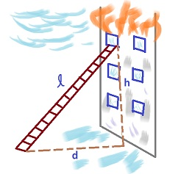
Pythagorean Theorem –
A firefighter leans a 30 foot tall ladder against a window on the third story of the building. He sets the base of the ladder 18 feet away from the building. How tall is the window?
Dailies Set #10

Slide 47


Right Angle –
How many right angles are inside of this cross?

Slide 48

Tip –
At a restaurant, you have a good waitress. You decide to tip her 15% of the bill. If your bill is $42.39, how much money should you give her?

Slide 49

Discount –
You are furnishing your new home. Your best friend’s dad owns a furniture store. He says he will give you an additional 10% off whatever you buy. You buy a couch that originally costs $990.00. However, it is 35% off. How much will you pay for the couch if you get the 35% off and then an additional 10% off?

Slide 50

Associative Property –
Carson is asked to multiply
(36 x 20) x 5 using only mental math. Describe how the associative property can help Carson solve this problem.

Slide 51

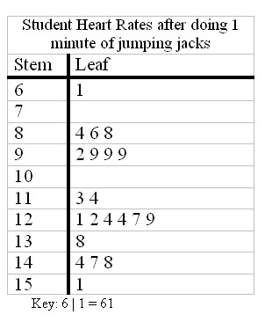
Stem-and-Leaf Plot –
What is the median student heart rate after 1 minute of jumping jacks?
Dailies Set #11

Slide 52

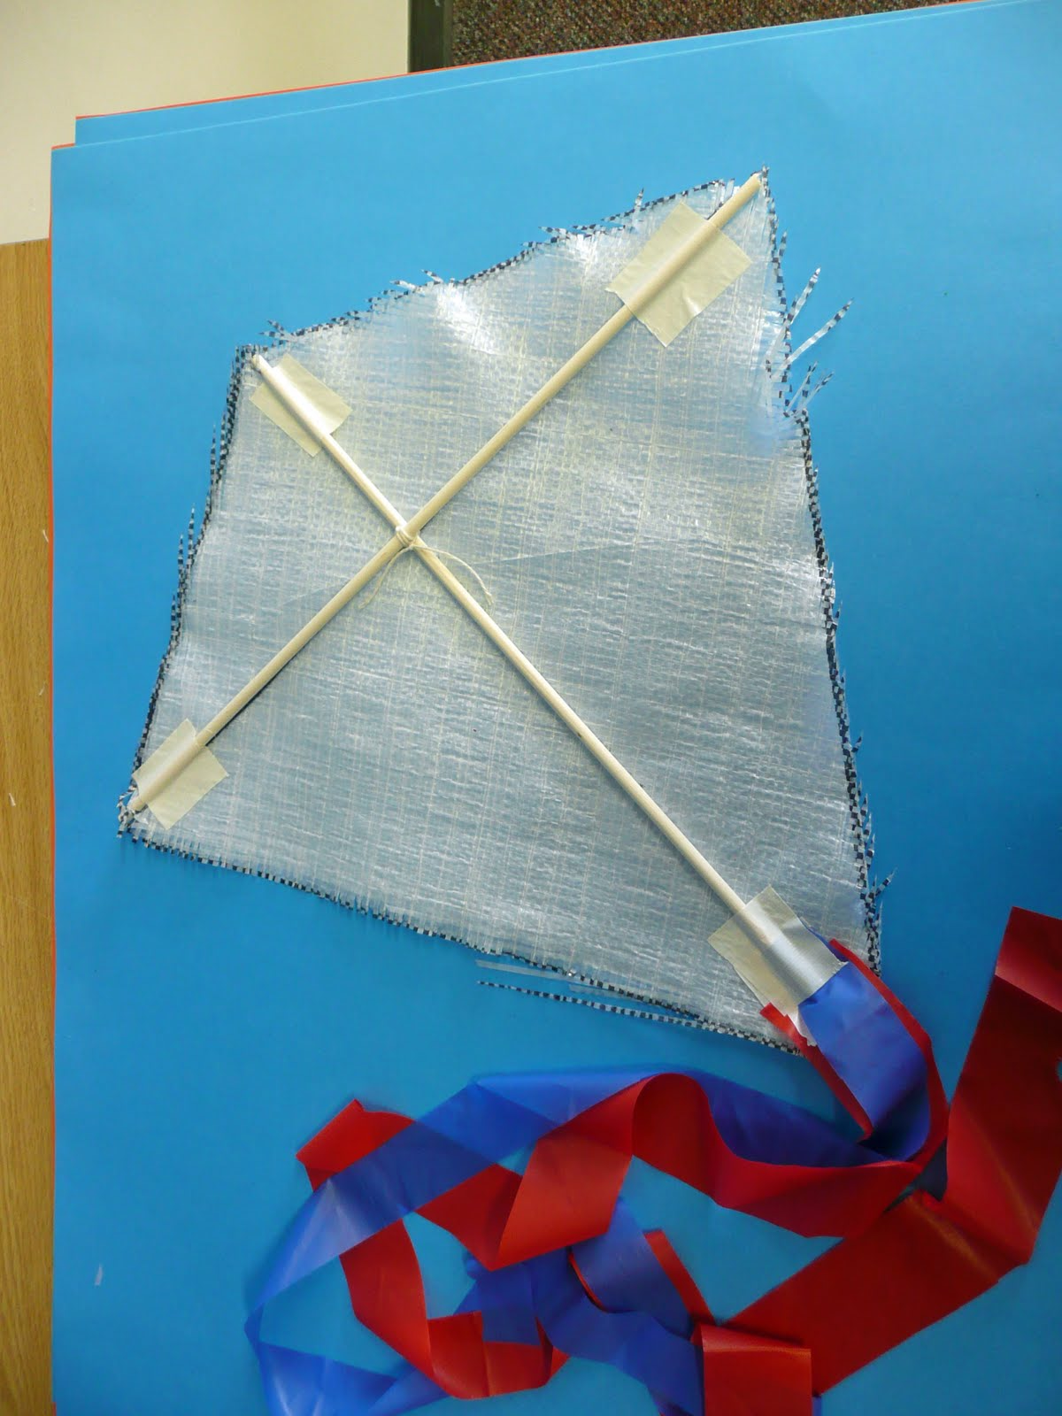
Bisect –
In this picture of a homemade kite, in what ways does the kite model bisecting?

Slide 53
Commission –
You are an automotive salesman. You earn a monthly salary of $250.00 plus a commission of 5%. Last month you sold 5 vehicles worth the following amounts $2,500, $8,650, $10,575, $5,820, and $6,100. How much money did you earn in all?

Slide 54

Mean (Average) –
Johnny bought some chairs at an average price of $37. If he decided to buy one more chair for $85, the average price would become $43. How many chairs did he buy?

Slide 55

Biased Sample –
Mrs. Stevens works in the cafeteria. She wants to know what dessert most students would like to see added to the lunch entrée. She has four ideas for asking the students. Explain which method will be the least biased?
A. Get a list of all the students in the school and choose all the students with last names A-M.
B. Asks all the students who currently buy the entrée.
C. Give each student a raffle ticket as they enter the cafeteria and then draw out 50 ticket numbers.
D. Ask all the sixth graders, since they will be in the middle school the longest.

Slide 56


Capacity –
You are the supplier of the new 2013 Easton S1 Junior Big Barrel Baseball Bat. The bat is 25 inches long with a 2 ¾ inch barrel diameter.
If your shipping box has a capacity of 234 cubic inches, what could be the length, width, and height of the box?
Dailies Set #12

Slide 57

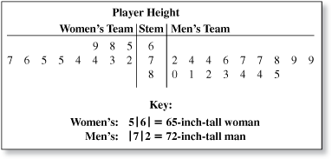
Box-and-Whisker Plot –
Construct a box and whisker plot to show the men’s team’s heights.

Slide 58

Celsius –
The average temperature of a dog is 38 degrees Celsius. The average temperature of a human is 98.6 Fahrenheit . How many degrees warmer in Fahrenheit is a dog than a human?

Slide 59

Certain –
Explain whether each situation is “certain,” “impossible,” or “equally likely.”
1. If you had a fair number cube with sides 1-6, what is the probability of rolling a 9?
2. Evan had 6 red pencils and 5 green pencils. If he grabs one at random what is the probability he will grab either a red or green pencil?
3. Bill had 8 pieces of chocolate candy and 8 pieces of caramel. If he picks one at random, what is the probability he will pick a chocolate piece?

Slide 60

Simplify –
Kent is asked to simplify the following expression.
300 – 16 ÷ 2 ● 2 + 14
Kent says the answer is 310. Is Kent correct? Specifically, what mistake did Kent make?

Slide 61

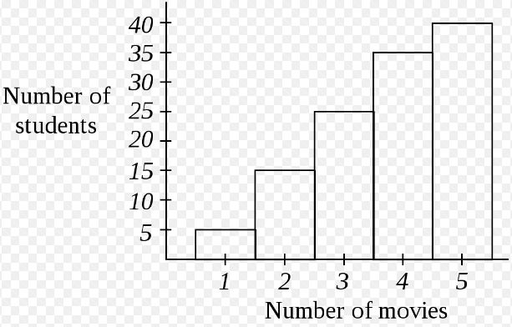
Denominator –
Allison asked her peers how many movies they have watched in the past month and recorded her results in the histogram below. What fraction of her peers have watched four movies?
Dailies Set #13

Slide 62

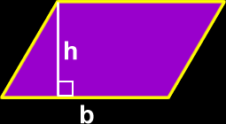
Parallelogram –
Explain using pictures and words how a parallelogram is related to a rectangle.

Slide 63
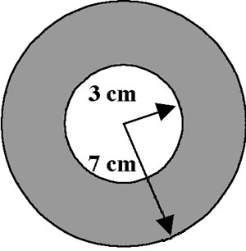

Pi (π) –
A washer for a piece of machinery has an internal diameter of 3 cm and a total diameter of 7 cm.
What is the area of the washer (the shaded region)?

Slide 64
Scale Drawing –
On a blueprint of a house, the length of a den area measures 3 ¾ inches. If the scale is ½ in:6 ft, how long is the room?

Slide 65

Work Backwards –
Sara is trying to estimate what time she woke up this morning. It is now 10:20. So far this morning, she has worked 2 ¾ hours, drove to work (40 minutes), got ready for work (35 minutes), ran 6 miles(1 ¼ hours), and got ready for her run (10 minutes). Approximately what time did Sara wake up this morning?

Slide 66

Quadrant –
Draw a coordinate plane. Then, draw a square on your coordinate plane that has one vertex in each of the quadrants. Label each vertex with a point (A,B,C, and D). Then, tell what quadrant each point lies in and the point’s ordered pair.
Dailies Set #14

Slide 67
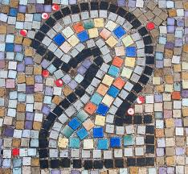
Equivalent –
If 3y + 6x is equivalent to 75 + y + y + y, what is the value of x?

Slide 68

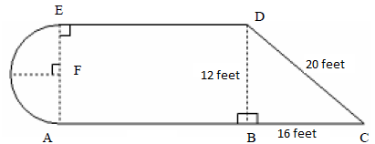
Perimeter –
The shape of a patio at a restaurant is blueprinted below. How many feet of fencing would be needed to enclose the patio?
25 feet

Slide 69

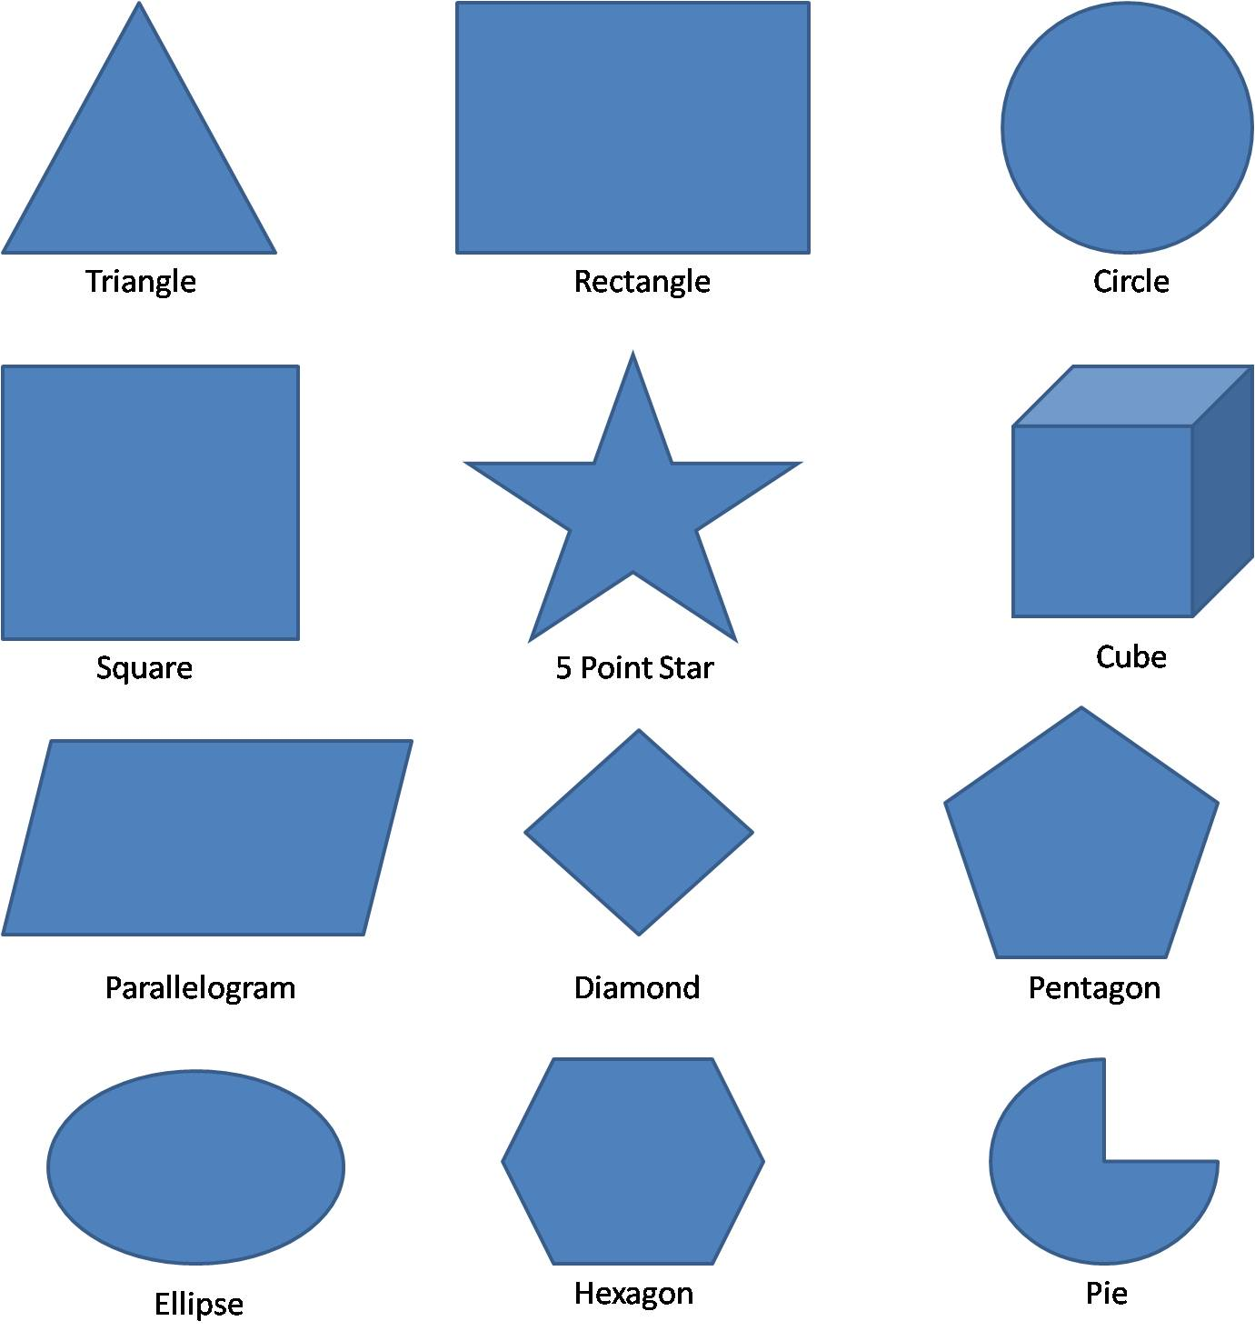
Perpendicular Lines –
Which of the shapes to the right can model perpendicular lines?

Slide 70
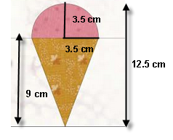

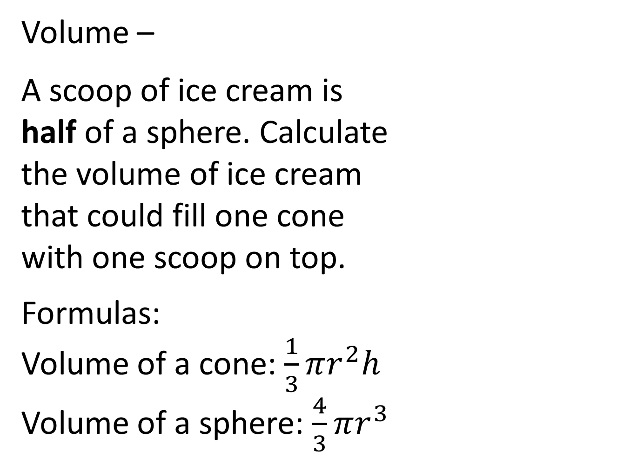
Volume –
A scoop of ice cream is half of a sphere. Calculate the volume of ice cream that could fill one cone with one scoop on top.
Formulas:
Volume of a cone: $\frac{1}{3}πr^{2}h$
Volume of a sphere: $\frac{4}{3}πr^{3}$

Slide 71

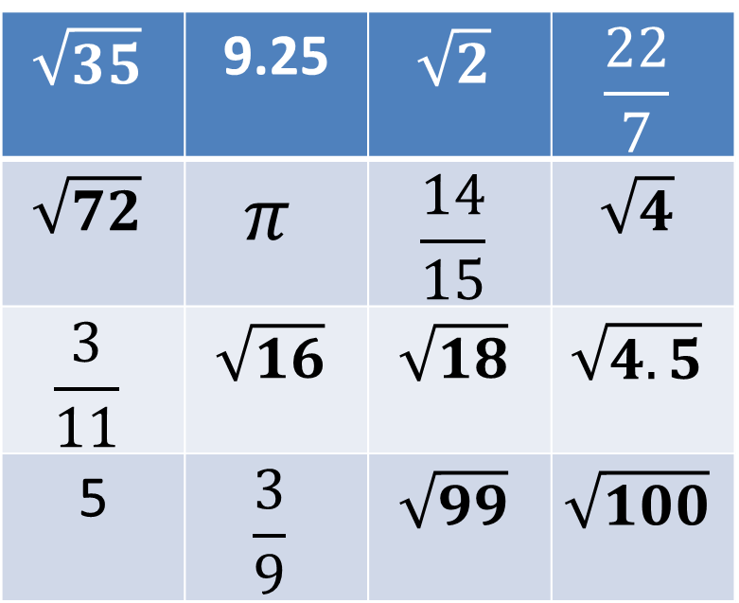
Irrational Number –
Use a calculator to find the 8 irrational numbers below:
Dailies Set #15
$$\sqrt{35}$$ | 9.25 | $$\sqrt{2}$$ | $$\frac{22}{7}$$
$$\sqrt{72}$$ | $$π$$ | $$\frac{14}{15}$$ | $$\sqrt{4}$$
$$\frac{3}{11}$$ | $$\sqrt{16}$$ | $$\sqrt{18}$$ | $$\sqrt{4.5}$$
5 | $$\frac{3}{9}$$ | $$\sqrt{99}$$ | $$\sqrt{100}$$

Slide 72
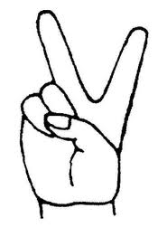
Prime Number –
James and Harley’s teacher asks them to find the sum of the first ten prime numbers. James believes the sum is 101. Harley believes the sum is 129. Prove who, if either, is correct.

Slide 73

Percent Increase –
Walmart carries Mickey Mouse Clubhouse DVDs. They purchase them wholesale for $8.50 each. They then sell them for $12.92. By what percent has Walmart increased the price of their item?

Slide 74

Simple Interest –
To purchase a home, Kenley must have a 20% down payment. She plans to purchase a home worth $110,000. Therefore, she needs $22,000 as her down payment. Her parents agree to loan her the money necessary for the down payment and will charge her a simple interest rate of 3%. How much will Kenley have to pay her parents back in all if she plans to pay them back within 6 years? How much should she pay to her parents each month to ensure that the loan is paid off in exactly 10 years?

Slide 75

Euler Circuit –
A remote control is handled by a small circuit board that requires a Euler Circuit in order to maintain power. Which of the following designs could be a sketch of the remote control’s circuit board?

Slide 76

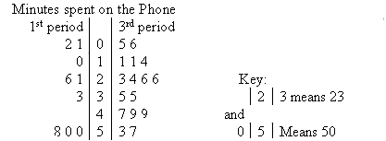
Median –
After a short survey, Mrs. Daniel collected the following information about her students’ phone habits. How do 1st and 3rd period’s median number of minutes spent on the phone compare?
Dailies Set #16

Slide 77
Factorial –
Mrs. Neil is typing a list of eight students who have been chosen for a reward at the upcoming Academic Banquet. How many choices of ways to list the students does Mrs. Neil have?
2

Slide 78
Prime Factorization –
Use prime factorizations to solve this problem.
You have 120 red beads, 100 white beads, and 45 blue beads. You want to use all the beads to make identical bracelets that have red, white, and blue beads on each. What is the greatest number of identical bracelets you can make? How many of each color will be on each bracelet?

Slide 79
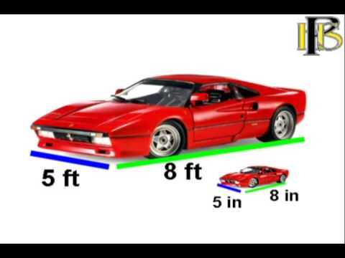
Scale Factor –
A model of a car is built and show in the picture below. What is the scale of the model?

Slide 80
Withholding Tax –
Vince gets paid biweekly a gross income of $2,307.69. Of that amount, $281.54 gets withheld for Federal Taxes and $87.69 gets withheld for State Taxes. What percent of his income is withheld for taxes?

Slide 81
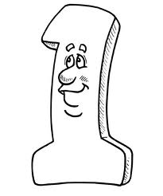
Positive Correlation –
Which of the following situations would have a positive correlation? Why?
1. The height of a tree and the number of years old it is.
2. The height of a person and the grade he or she received on the last math test.
3. The price of popcorn at the movies and the number of pieces of popcorn you receive.
4. The diameter of a pepperoni pizza and the number of pepperonis received.
5. The cost of gas and the number of gallons you can buy with $10.
Give one additional example of a positive correlation.
Dailies Set #17

Slide 82

Random Sample –
You are asked by the principal to survey the middle school to see what sport they would like to play at the upcoming fun day. Explain a way to randomly sample 50 students from the middle school.

Slide 83

Evaluate –
Sam was asked to solve the problem below. Is Sam correct? If not, what mistake(s) did Sam make and what is the correct answer?
4(2³-7) – 5²
4(16-7)-25
4(9)●25
36 ●25
960

Slide 84
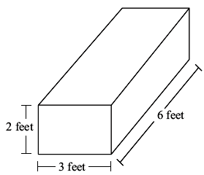

Surface Area –
Callie’s birthday is coming up. Her mother buys her a present that is in a rectangular box, as shown to the left. How many square feet of wrapping paper are needed to cover the entire box?

Slide 85

Exponent –
What is the value of 1² + 2³ + 3⁴ + 4⁵ ?

Slide 86

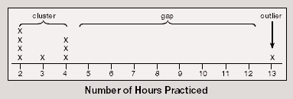
Outlier –
The data below represents the number of hours that Kyle has practiced basketball in the past 9 weeks. Calculate the mean, median, mode, and range of the data. Then, explain which measure of central tendency (mean, median, mode or range) best represents Kyle’s practice.
Dailies Set #18

Slide 87

Negative Correlation –
Which of the following situations would have a negative correlation? Why?
1. The temperature outside and the number of gallons of oil needed to heat your home.
2. The number of hours spent studying and the score on your math test.
3. The number of minutes spent running on a treadmill and the number of calories burnt.
4. The length of the lines at an amusement park and the number of rides you can ride in one day.
5. The age of a tadpole and the length of its tail.
Give one additional example of a positive correlation.

Slide 88

Quarterly –
I agree to give Addaleigh and Cohen an allowance. I give two offers. Offer #1: $1.00 doubled quarterly for 3 years. Offer #2: $20.00 per week for 3 years. Addaleigh chooses offer #1 and Cohen chooses offer #2. Who will receive the most money? How much more money will that person receive in the 3 years?

Slide 89

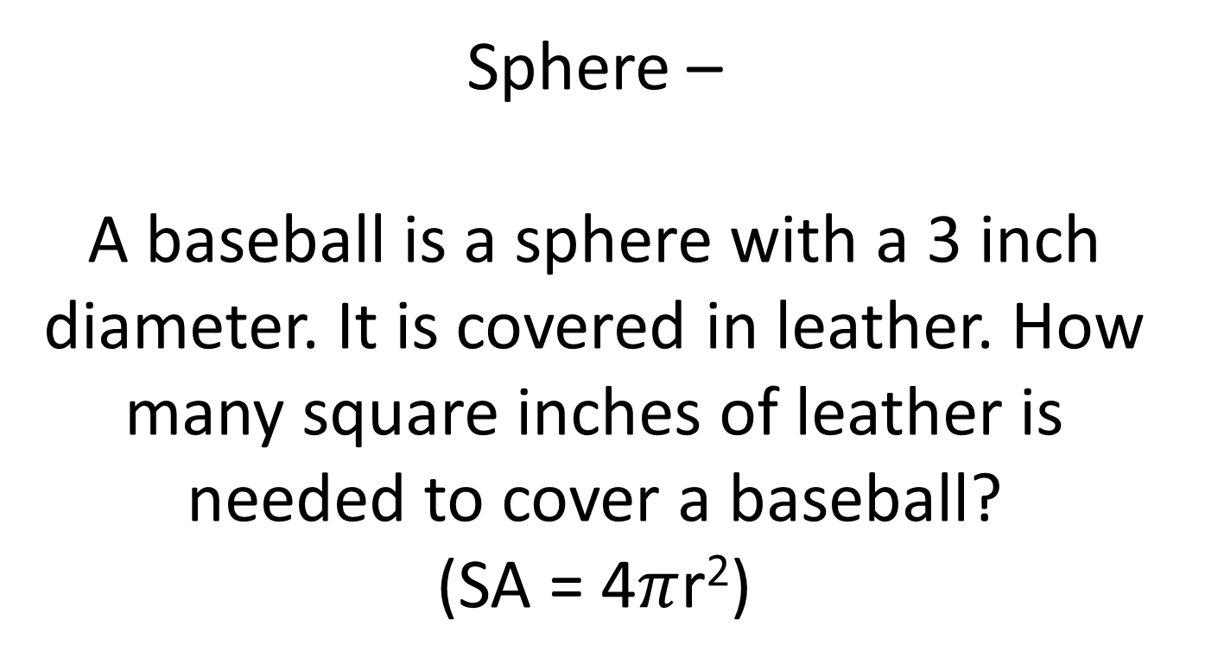
Sphere –
A baseball is a sphere with a 3 inch diameter. It is covered in leather. How many square inches of leather is needed to cover a baseball?
(SA = 4$π$r²)

Slide 90
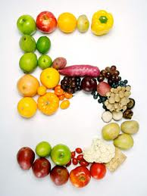
Transformations –
Translation –
Rotation –
Reflection –
Choose a uppercase letter that is NOT symmetrical (ex. A is symmetrical). Then, draw and label a translation of the letter, a rotation of the letter, and a reflection of the letter. (4 pictures total – an original, a translation, a rotation, and a reflection).

Slide 91

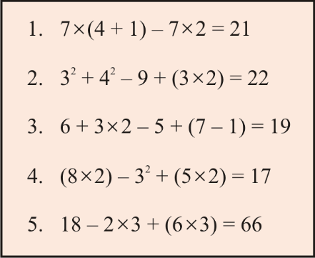
Order of Operations –
James had 5 questions for homework. To the right are his questions and answers. Work each of James’ questions to determine which of his answers are correct. What percent of the worksheet did James get correct?
Dailies Set #19

Slide 92
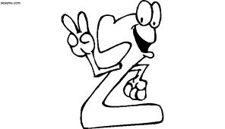

Tessellation –
Below is a tessellation made of two shapes. Create a tessellating design using two shapes.

Slide 93
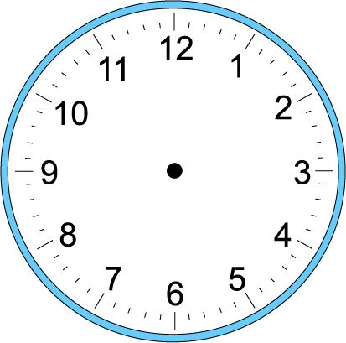

Time –
Anna has a doctors appointment. She looked at the clock when she left the house in the morning and when she returned in the afternoon. How long was she gone?
Left
Returned

Slide 94
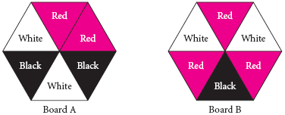
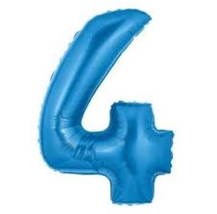
Theoretical Probability –
A game is played by spinning two colored spinners. If you land on black on both spinners, you receive an extra turn. What is the theoretical probability of landing on black, then black?

Slide 95
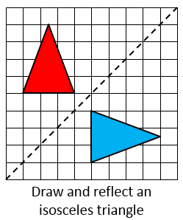
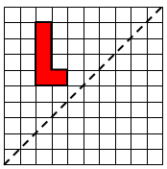
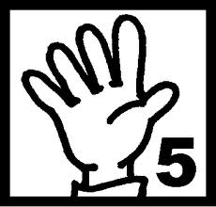
Line of Reflection –
Create a perfect reflection over the line y=x.
Example: You Try:

Slide 96
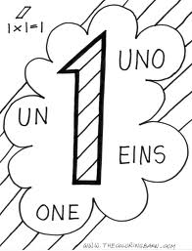
Percent Decrease –
A house for sale by Exit Realty has recently had a price reduction. Originally listed for $205,000, it now costs $188,600. By what percent did the seller agree to discount the price?
Dailies Set #20

Slide 97
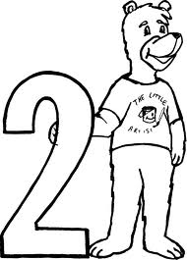
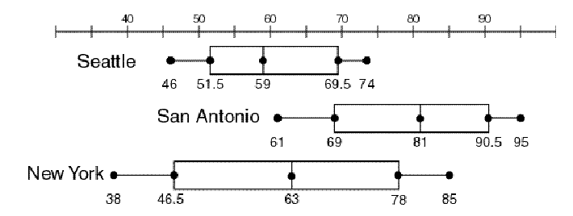
Range –
Using the box-and-whisker plot below, write at least one sentence comparing the range of temperatures for these three cities. Be specific in your comparison.

Slide 98
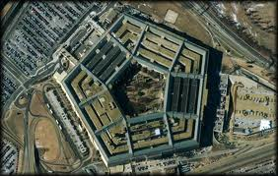

Regular Polygon –
Samuel is planning to draw a scale drawing of The Pentagon. Since The Pentagon is a regular Pentagon, how many degrees should he draw each of the five angles?

Slide 99

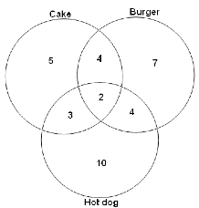
Venn Diagram –
At Reagan’s birthday party, burgers, hotdogs, and cake were served and each person’s choice of food was recorded in the Venn Diagram to the right. How many people ate at the party?

Slide 100
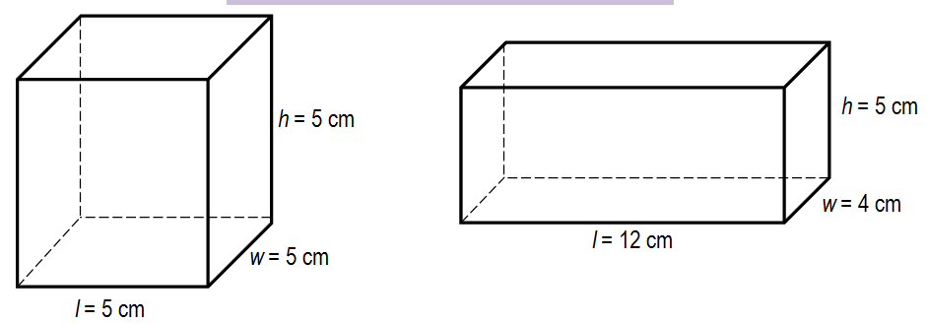

Rectangular Prism –
A food company is considering two designs for their new product’s packaging. How much greater is volume of the design on the right than the design on the left?

