Slide 1
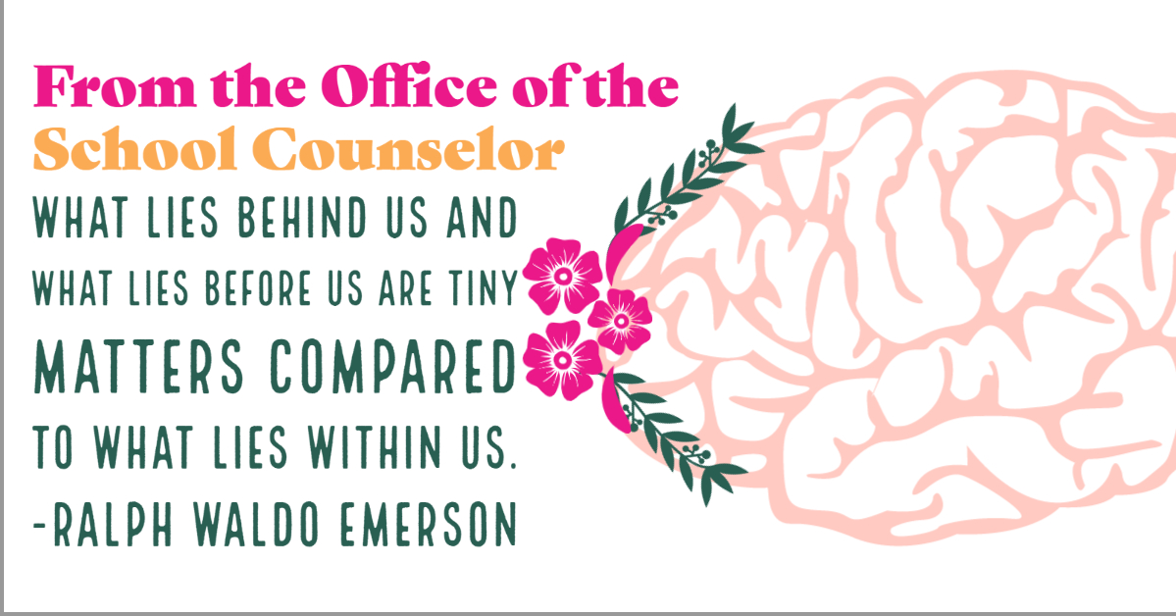
Comprehensive elementary school counseling program
An overview

Slide 2
Comprehensive program elements
Our comprehensive school counseling program works to promote and foster academic, career, and personal-social development while meeting the unique needs of each and every student.
Notes:
The following slides detail the comprehensive school counseling program within our elementary school building, grades K through 5. Our comprehensive school counseling program works to promote and foster academic, career, and personal-social development; all of which are embedded within the program to meet the unique needs of every student.

Slide 3
Comprehensive program elements
ACADEMIC PROGRAM ELEMENTS:
Addressing the needs of the whole child to promote equitable academic achievement and access to services
Avoidance of core instruction time (with the exception of emergencies/responsive services)
Standards blending
Vertical articulation
Data-driven outcome studies
Notes:
The comprehensive counseling program works to support the academic needs of each child. This starts by addressing the needs of the whole child to promote equitable academic achievement and access to services. The school counselor will work to identify achievement gaps and work to provide appropriate strategies. In identifying achievement gaps, the counselor also identifies any possible correlations between students who have been identified in the gap. The counselor then works as a social advocate for that population. In addition to examining pre-existing data, the counselor may also work to procure additional data through surveys and observations. Individual observations of at-risk students will also be performed to support the needs of each child, utilizing this as a means of collaboration and consolation.
If possible, all counseling activities are performed during times which the children are not involved in core-instruction time. This ensures each child continues to be involved in the core-curriculum and is successful academically.
The counseling program also works to incorporate standards blending into each classroom counseling lesson. Standards blending is achieved through a combination of collaboration with teachers and adhering to state academic standards. The standards blends are matched with where the classroom is currently in their academic year. Various standards blends, English Language Arts, Mathematics, Social Studies, etc. are incorporated. In administering counseling services, vertical articulation is also utilized. For example, counseling lessons are age-appropriate and build on each other during the year and throughout the child’s school career.
Data-driven outcome studies (achievement data) are utilized to support and guide the program. Pre and post-test data is collected during each classroom lesson to ensure that the lesson is appropriate and effective. For example, this data allows for standard blends to be adjusted as needed to support any achievement gaps that are identified for the student population. Access and attainment data are also examined to promote systemic change and address equity concerns. Data is a major component which contributes to creating pathways, reaching milestones, and examining quality (Erford, 2019).

Slide 4
Comprehensive program elements
CAREER PROGRAM ELEMENTS:
Classroom lessons to meet Pennsylvania Career Education & Work Standards
  Career awareness and preparation (exploring and learning about yourself)
  Career Acquisition (getting a job)
  Career retention and advancement (keeping a job)
  Entrepreneurship (creating a job)
Making important connections between school and future success
Notes:
In order to address important career and work education standards, the comprehensive guidance program begins implementing career and work education lessons during classroom (guidance) lessons beginning as early as kindergarten. The incorporation of career education is age-appropriate, also governed by the Pennsylvania Career and Work Standards. Pennsylvania requires that by the 6th grade each student is able to provide six pieces of evidence they engaged in career education and work exploration, a minimum of one from each domain (career awareness and preparation, career acquisition, career retention and advancement, and entrepreneurship). The counseling program ensures that well over six pieces of evidence are procured by the 6th grade in order to establish a well-rounded and vertically articulated career program. The counseling program also works to ensure that important connections between school and future success are made. This includes highlighting the importance of education (academic or vocational) to obtain a career, developing characteristics that help to obtain and maintain a job, as well as correlating attendance in school with the importance of attendance in a career. Additionally, the program emphasizes exploration and does account for Happenstance, helping students to understand that our career is a very unique journey, not a strict/set path.
The counseling program also collaborates with community stakeholders to encourage local career and work development. For example, the fifth grade class participates in a field trip to the local technical school and a STEM career awareness exploration activity. Fifth grade students also have the opportunity to explore local job opportunities and interview someone within the local community. The community should be explored broadly, taking the time to identify stakeholders and encourage community involvement and support in career program efforts (Gibbons, M. M., Brown, E. C., Daniels, S., Rosecrance, P., Hardin, E. E., & Farrell, I., 2019).
As students are developing a basic sense of themselves, career and work exploration is an important goal to reach, establishing a solid foundation with which they can build on and clarify during their secondary experience (Erford, 2019).

Slide 5
Comprehensive program elements
PERSONAL-SOCAL DEVELOPMENT PROGRAM ELEMENTS:
School-wide character & behavioral education programs
Classroom lessons; in accordance with ASCA Mindset & Behaviors (ASCA, 2014) for student success
Individual and group sessions
Proactive and reactive services
Needs assessments
Consultation and collaboration
Direct and indirect services
Notes:
Year-long, school-wide character and behavioral initiatives are implemented. GRRREAT (Give 100%, Responsibility, Respect, Right Choices, Encourage Others, Accept Differences, and Teamwork), a character initiative, rewards one student from each class each month for exemplifying the monthly acronym. The GRRREAT theme is incorporated into classrooms and students are graded on character. At the end of each semester there is a cumulative award (i.e. popcorn and a movie) for students who have displayed GRRREAT characteristics. Additionally, the counseling program also promotes a school-wide culture of attendance. Each semester every child is given a BINGO card and the game is played during morning announcements. As students win BINGO during the semester they may select from a range of prizes. These school-wide initiatives work to lessen behavioral issues/referrals and close the attendance gap. As new evidence to support additional gaps presents itself we will incorporate additional school-wide initiatives.
As aforementioned in academic program elements, classroom (guidance) lessons also work to promote personal and social development. Classroom lessons are structured to address ASCA Mindset and Behavior Standards (ASCA, 2014) in order to promote student success. Each classroom lesson is age-appropriate, occurring once a month. This not only fosters social/emotional growth, but establishes an ongoing relationship between each student and the school counselor. Each month’s lesson focus also aligns with the school-wide character and behavioral education program’s (GRRREAT) monthly theme.
The counseling program also provides other direct services, such as individual and group counseling. Counseling services are a combination of proactive and reactive services. If a need is identified, individual or group sessions are initiated. In the instance of classroom lessons, these are generally proactive (but also at times adjusted to be reactive) to support and promote a positive school climate.
School-wide incentives, classroom lessons, and individual and group counseling services are the direct result of needs assessments, consultation, and collaboration. Needs assessments are distributes quarterly to teachers and semi-annually to parents in order to help identify new gaps/areas of focus and support or refute present intervention strategies. Parents, teachers and stakeholders also work together with the counseling program, consulting and collaborating about what services are needed. Collaboration and consultation is an indirect service provided to support the needs of students, identifying direct services needed.

Slide 6
advocacy
It is the school counseling program’s goal to promote equitable educational practices and maintain a responsive school climate in which individual differences are respected and welcomed, ultimately benefitting the surrounding community. Students within the school are advocated for in the following ways:
Community-based partnerships/alliances
Providing community supports and advocacy for the greater community
Needs assessments
Data-driven goals with strategic planning
Ongoing professional development
Core-curriculum which works to overcome barriers and advocate for all
Providing information to parents and encouraging connections at home
Notes:
It is the school counseling program’s goal to promote equitable educational practices and maintain a responsive school climate in which individual differences are respected and welcomed, ultimately benefitting the surrounding community. Students within the school are advocated for in many ways. Community-based partnerships and alliances are developed and maintained as a way in which the greater community can help to support and advocate for students, as well as the school taking initiative in working with community-based groups for advocacy issues in the surrounding area, making sure that all have an equitable opportunity and voice. Needs assessments are also conducted with students and parents in order to isolate issues that the community may have and like to see addressed. Data-driven goals with strategic planning is another way in which the counseling program works to ensure advocacy. Goals are supported by data and represent an overall desired outcome for the students and greater community (Erford, 2019). The core-curriculum also works to overcome barriers and advocate for all. Classroom lessons work to address issues of classism, sexism, racism and ethnocentrism. For example, Career and work education program works to overcome stereotypical gender barriers by exposing children to men and women who work in non-traditional careers. Gender-based process elimination is known to begin as early as age 6 (Erford, 2019).
During these lessons taught by the counseling departments, teachers stay in the classroom, working together to help students further apply the lesson with previous concepts. Teachers will also be aware of the lesson, to incorporate refreshers in the future. Teachers and counselors engage in regular professional development activities, ensuring these concepts are delivered appropriately. Additionally, following each counseling lesson, students are given a school counseling newsletter which provides information to parents about anything important occurring during that particular month. It is also a way in which valuable counseling lessons are shared with parents with a component that encourages connections at home, offering suggests with how parents can further advocate for their students and expand/reinforce the lesson.

Slide 7
Access, attainment & achievement
Building a comprehensive school counseling program requires implementation of access, attainment, and achievement data in order to measure progress.
Access: Creating and maintaining pathways to equitable engagement, resulting in equitable outcomes.
Attainment: Measuring the rate at which a goal is reached or completed; i.e. reaching milestones
Achievement: Examining the quality of what is being learned through test scores
In addition to understanding and utilizing these concepts to measure progress, the school counseling program and all other stakeholders must be able to believe and respond to the data that is identified.
Notes:
Building a comprehensive school counseling program requires implementation of access, attainment, and achievement data in order to measure progress.
Access data is defined as creating and maintaining pathways to equitable engagement, resulting in equitable outcomes. Attainment is defined as the rate at which a goal is reached or completed; i.e. reaching milestones. Achievement is the process of examining the quality of what is being learned through test scores
In addition to understanding and utilizing these concepts to measure progress, the school counseling program and all other stakeholders must be able to identify, believe, and respond to the data that is identified (Erford, 2019). Data is obtained through many different avenues, one of which includes referrals and collaboration/consultation. These individuals must be able to recognize access, attainment and achievement gaps. Additionally, once these gaps have been identified, all stakeholders must believe that there are disparities and there should be a response in order to achieve equity. The inability to recognize and respond to these disparities is an ethical issue, often rooted in an ability to overlook or misunderstand cultural and economic issues many face. If there is an inability for stakeholders to recognize such issues, this can become a political and legal issue (Erford, 2019). These are issues which the comprehensive school counseling department will face head-on via professional development activities and educational efforts.

Slide 8
Barriers to student development
Barriers to academic achievement and student well-being are a top priority to our culturally responsive school counseling program. The program’s vision has a commitment to social justice and a belief in equity, which places identifying and removing barriers to student development at the forefront. Barriers are identified via the following:
Systemic Assessments
Involving the community
  Community-School Partnership
  Community Advisory Boards
  Task Forces for Equity
Notes:
Barriers to student development are identified through systemic assessments. Systemic assessments include identifying needs of the students, as well as the larger community and school district; which includes subsystems and microsystems. Student’s needs should be filtered through an understanding of community strengths and values in order to be effective (Gibbons, M. M., Brown, E. C., Daniels, S., Rosecrance, P., Hardin, E. E., & Farrell, I., 2019). Data is disaggregated in order to create and implement data-driven goals (Erford, 2019). Through community and school partnerships, community advisory boards, and task forces for equity it is the counseling program’s mission to strategically and systematically work towards removing barriers to student development. The program’s vision has a commitment to social justice and a belief in equity.

Slide 9
References
American School Counselor Association (2014). Mindsets and Behaviors for Student Success: K-12 College- and Career-Readiness Standards for Every Student. Alexandria, VA: Author.
Erford, B. T. (2019) Transforming the School Counseling Profession. [Chegg]. Retrieved from https://ereader.chegg.com/#/books/9780134701028/
Gibbons, M. M., Brown, E. C., Daniels, S., Rosecrance, P., Hardin, E. E., & Farrell, I. (2019). Building on Strengths While Addressing Barriers: Career Interventions in Rural Appalachian Communities. Journal of Career Development, 46(6), 637–650. https://doi.org/10.1177/0894845319827652

